Slide 1
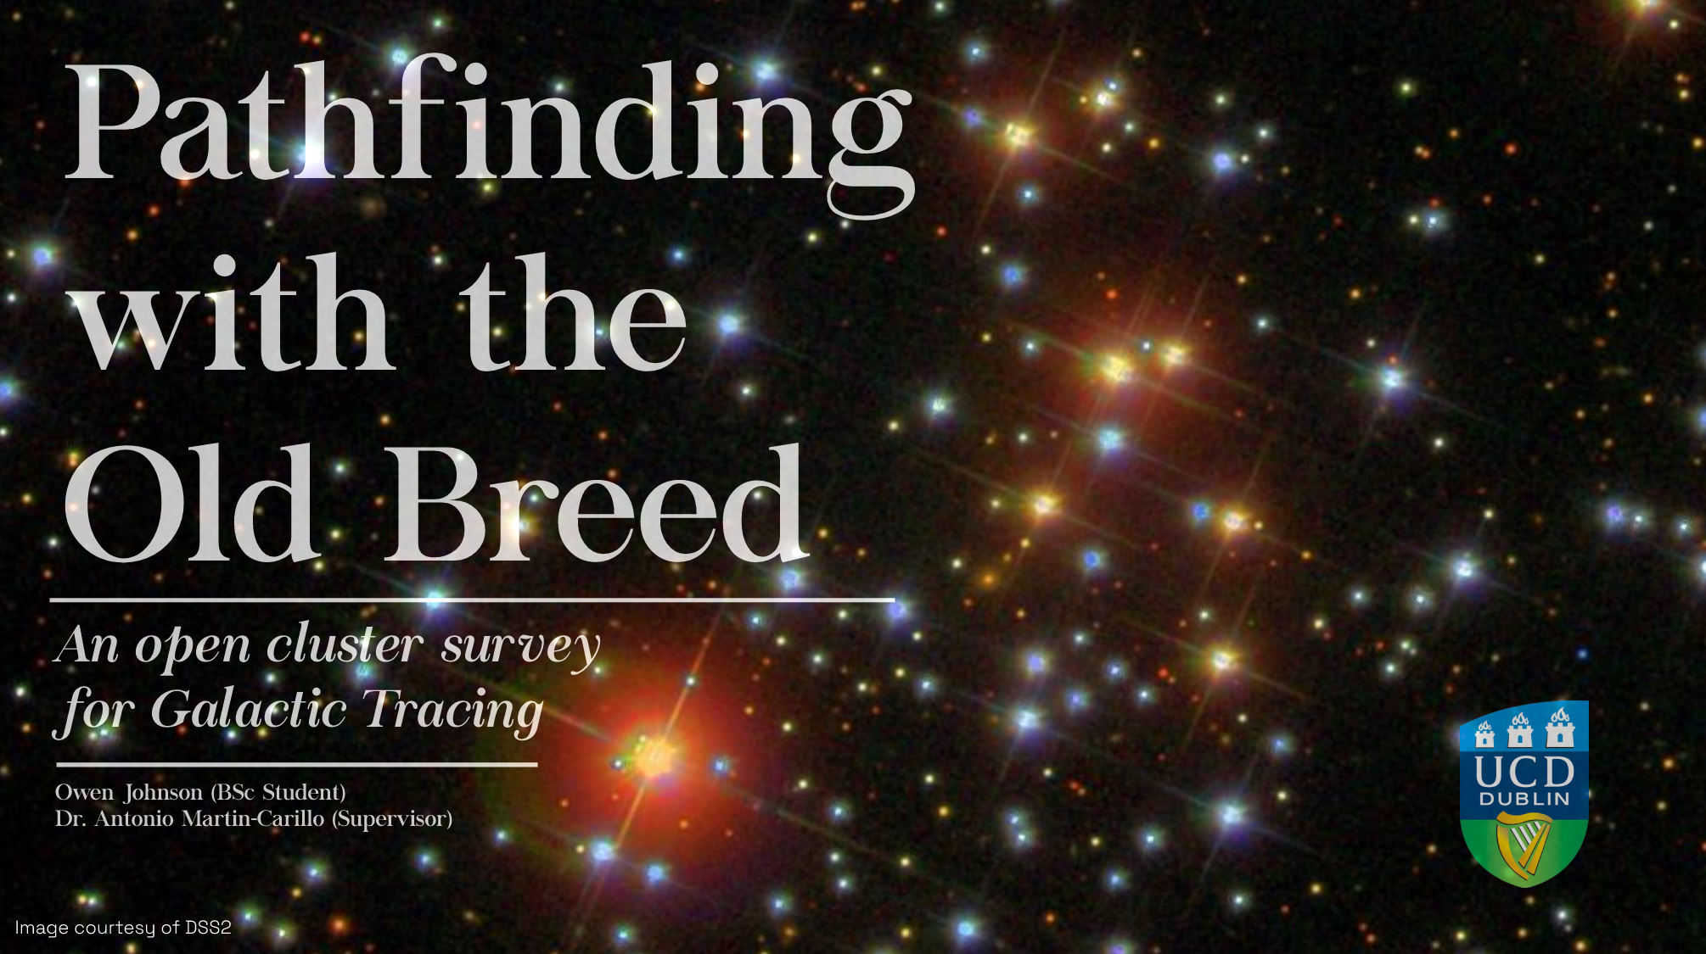

Slide 2
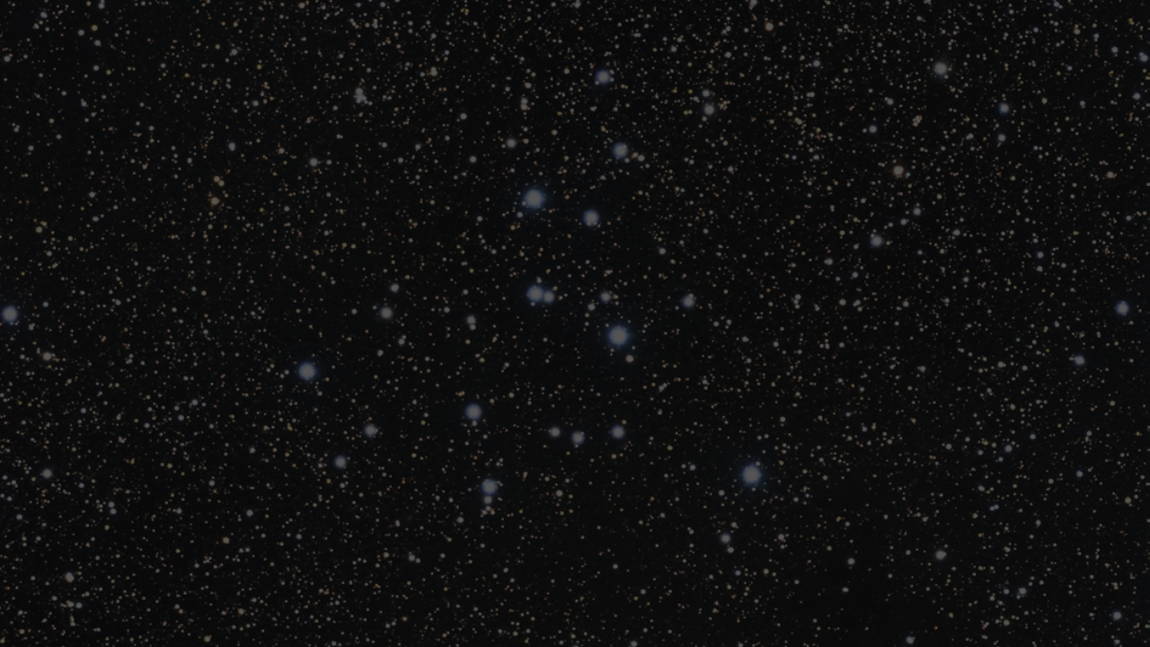
“The heavens are now seen to resemble a luxuriant garden, which contains the greatest variety of productions, in different flourishing beds.”
- Sir William Herschel

Slide 3

Objectives and Motivation
Primary Objective
Observe open cluster with little use in galactic tracing
Determine cluster’s population using methods from modern studies
Explore relationships between parameters and Galactic position.
Secondary Objective
Classify observed clusters according to the Trumpler scheme.
Nicely catalog stellar population of each observed cluster.
Motivation
Lots of data, no one to analyze.
Large development in isochrone research in the last 2 decades
Aid Gaia’s second data release (GDR2)
Resurgence of similar studies [Xiang, M., Rix, HW. (2022)]
I really like the idea of cataloguing stars

Slide 4
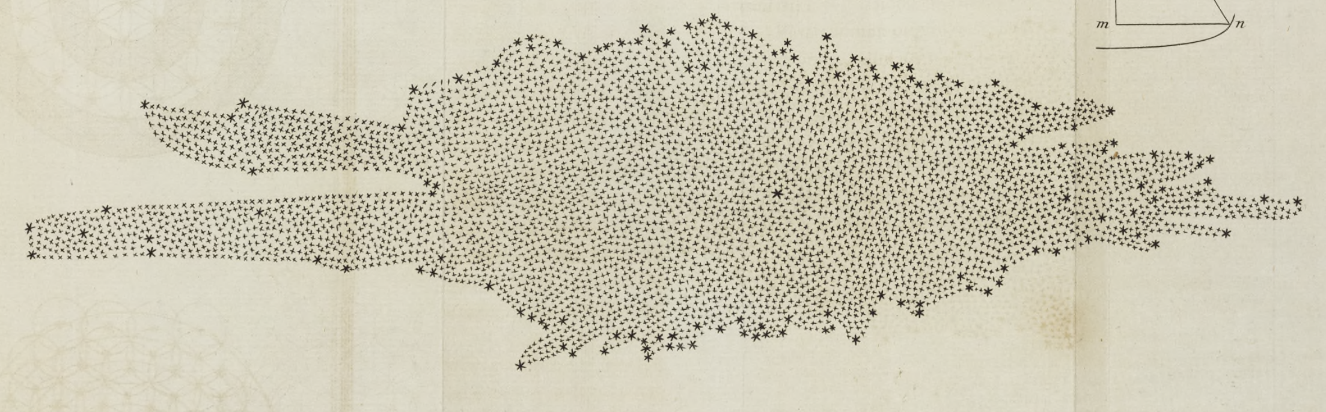
A Brief History on Galactic Tracing and Open Clusters
1785: William Herschel publishes ‘on the construction of the heavens’ detailing one of the first formal mappings of the milky way
1918 – 1930: Harlow Shapley & Robert Trumpler use classification schemes and cluster parameters to try relate milky way structure.
1960 – 90’s: Van de Burgh, Becker and Fenkart conduct first studies mapping the arms of the milky way using open clusters.
1980’s – 2010’s: Lynga and Janes
et al. perform mass isochrone fitting
and cataloging.
2010’s – Present: Dozens of machine
learning and statistical studies looking at 1000’s of clusters

Slide 5
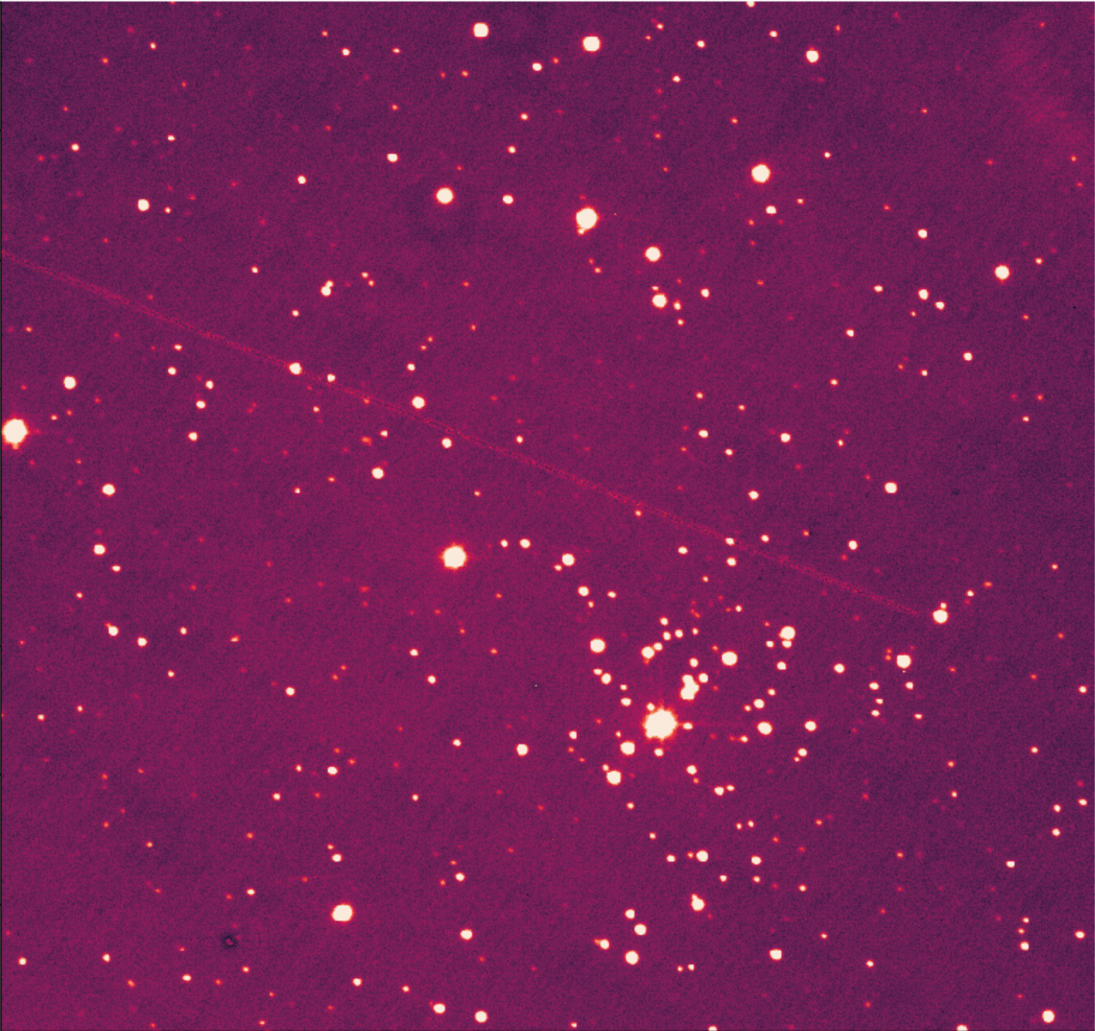
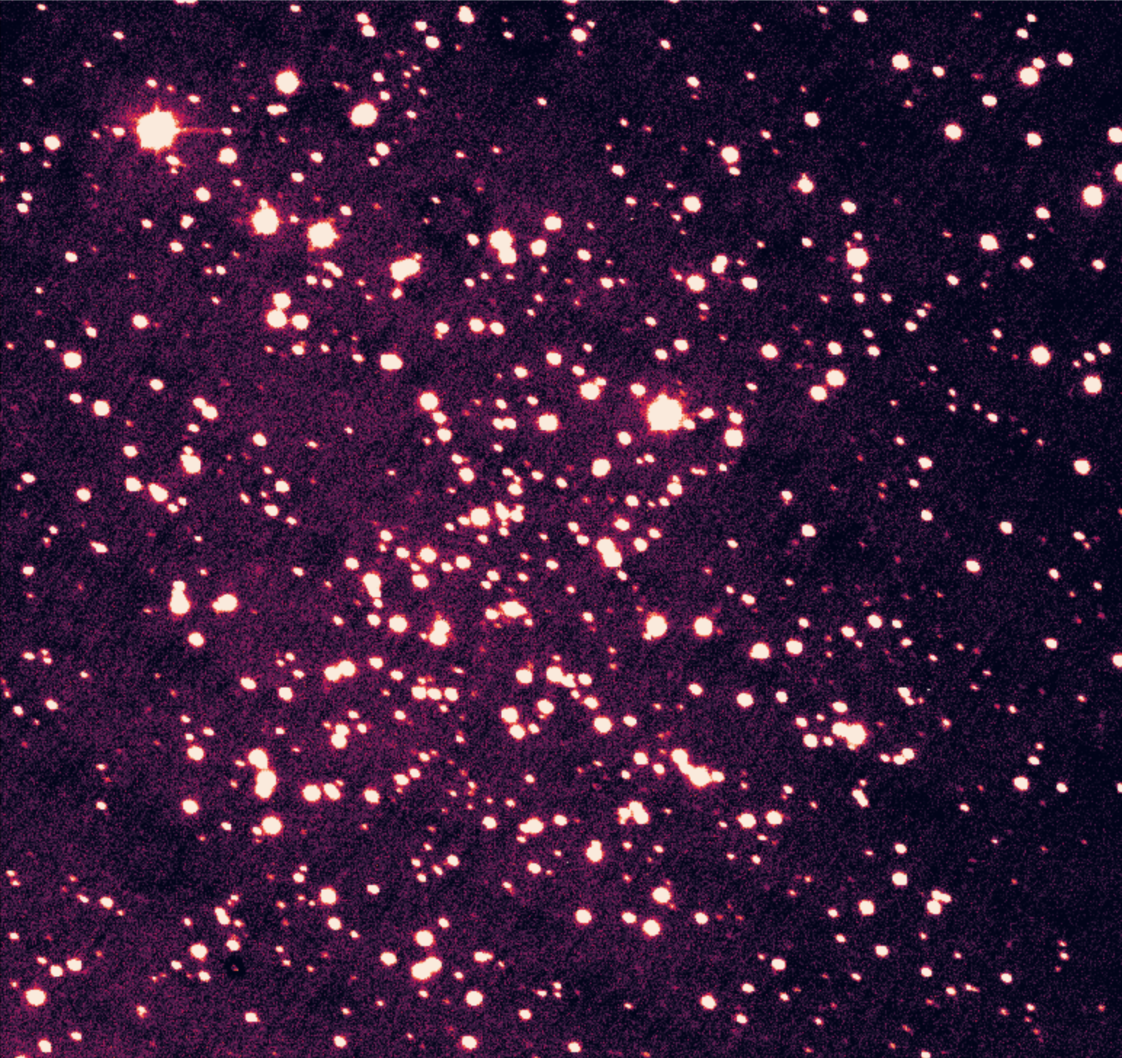
What are Open Cluster?
Berkeley 28
Collective stellar populations of a few stars to ~ 1000
Most are younger than globular cluster
Young: < 100 Myr
Old: > 1000 Myr
Loose gravitational bound
High metallic enrichment, comprised population I stars
Homogenous populations, makes them ideal to use as stellar laboratories.
NGC 2324

Slide 6
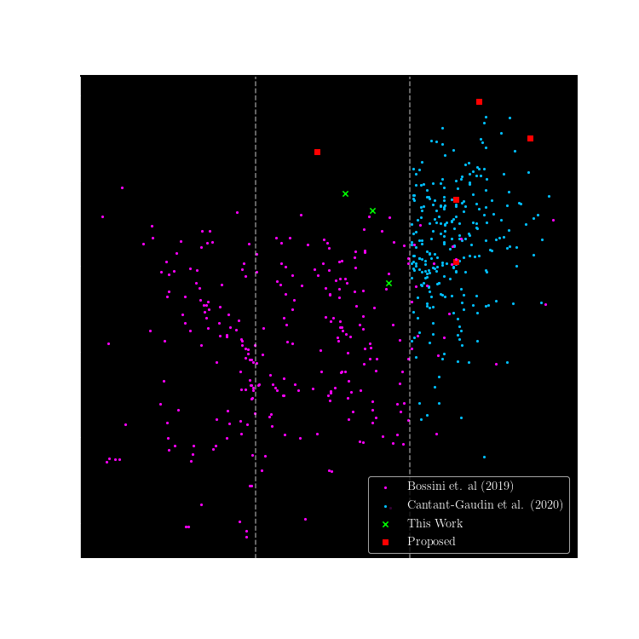
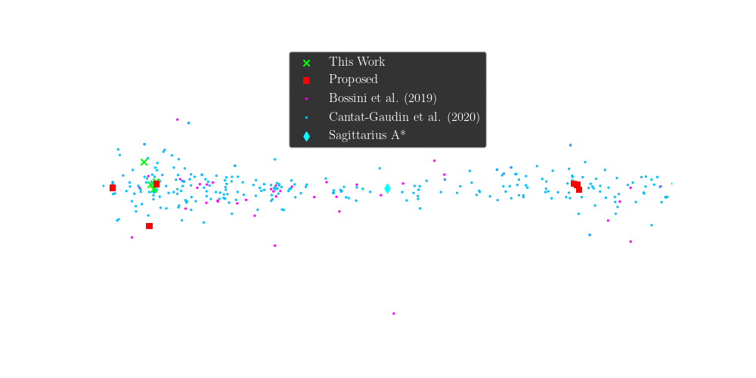
Target & Data Selection Strategy
Along with specific WEBDA studies

Slide 7
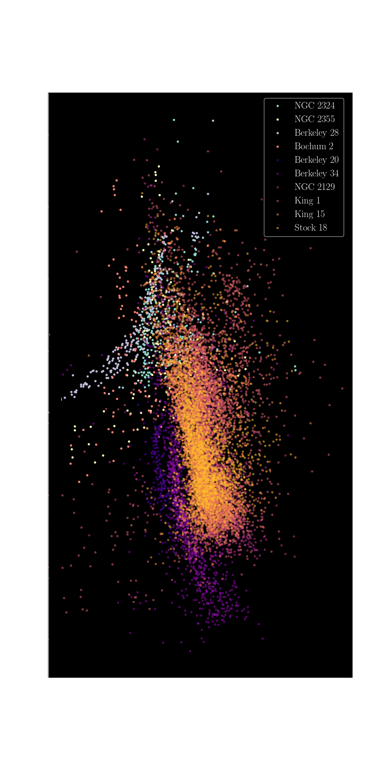
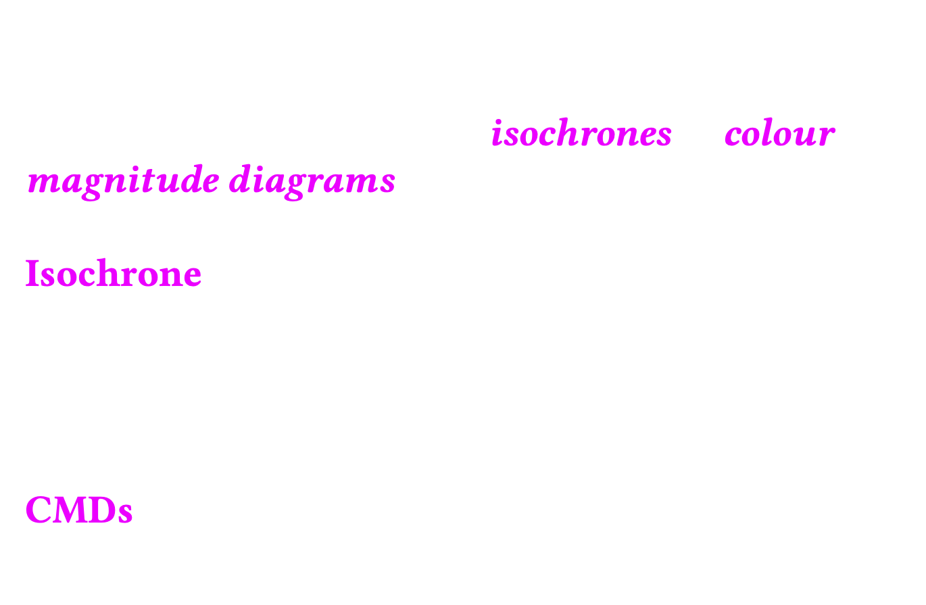
Determining Cluster Parameters
We’ve now have clusters of interest how do we learn about them?
Through fitting isochrones to colour magnitude diagrams (CMDs)
Isochrone $→$ a curve that can be fitted to a Hertzsprung-Russell (H-R) diagram that details the evolution of stars with specific parameters (age, Fe/H, Av, distance)
CMDs $→$ diagram variant of H-R diagram using magnitude (y-axis) and colour (x-axis)

Slide 8
Obstacles in Fitting Isochrones
The prominent problem in determining open cluster parameters
Are the detected stars members of the cluster?
Reason for problem: Open clusters have no discernable shape so that puts conventional spatial distribution profiling out the window

Slide 9
Possible Solutions to the Problem
Open Clusters do have a homogenous stellar population, we then turn to clustering on the CMD and metallicity distribution of targets!
Use of an astrometric study such as Gaia’s second data release to determine population members!

Slide 10
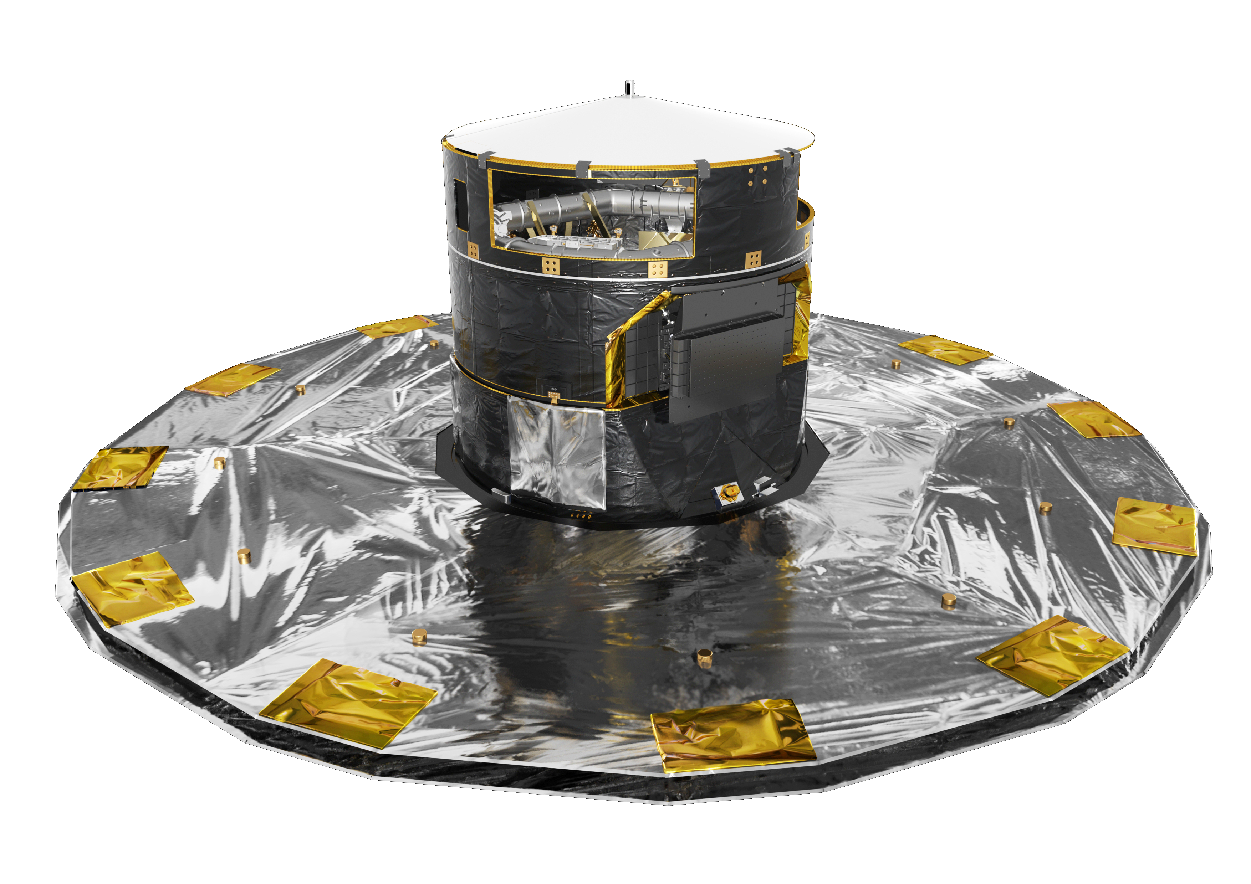
Possible Solutions to the Problem
Open Clusters do have a homogenous stellar population, we then turn to clustering on the CMD and metallicity distribution of targets!
Use of an astrometric study such as Gaia’s second data release to determine population members!
For this study we use Gaia’s parallax data! Due to its accuracy and similar approach in [Joshi. Y.C et al. (2014)], [Stott. J, (2018)] and Gaia DR2
Image courtesy of ESA

Slide 11
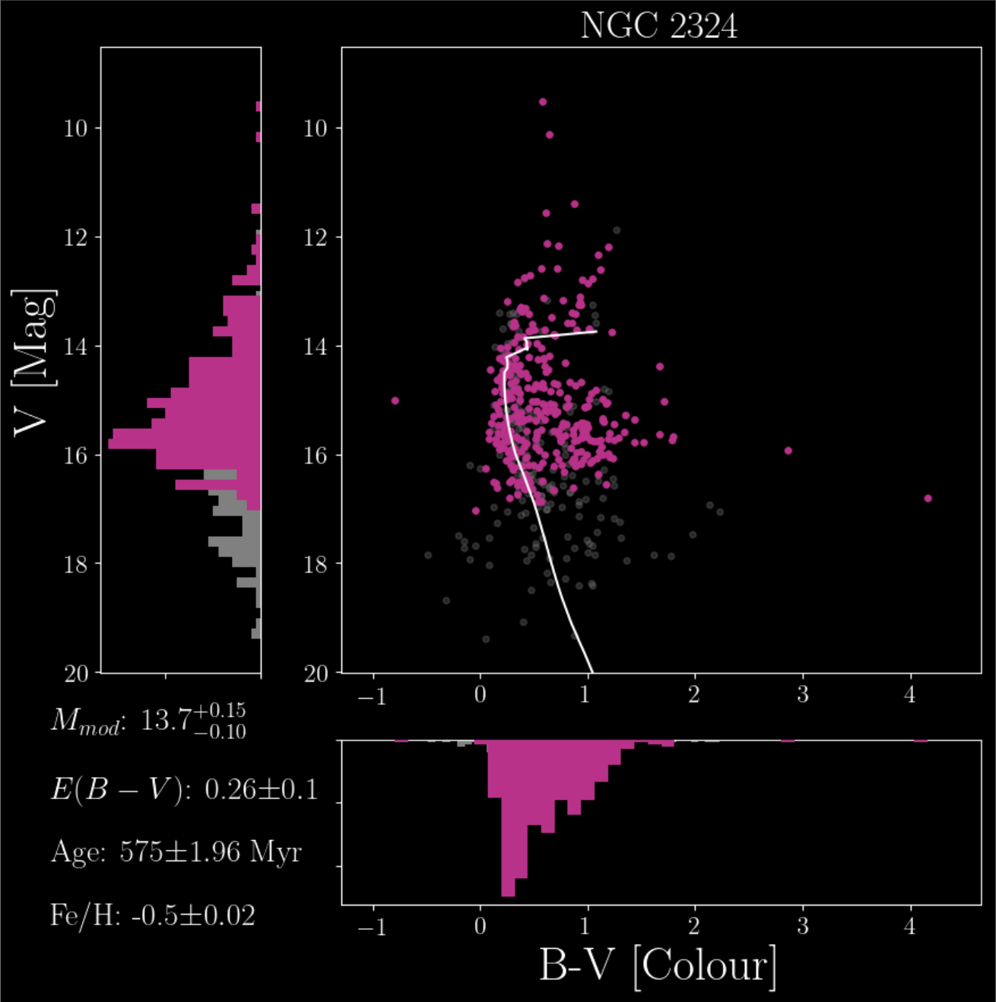
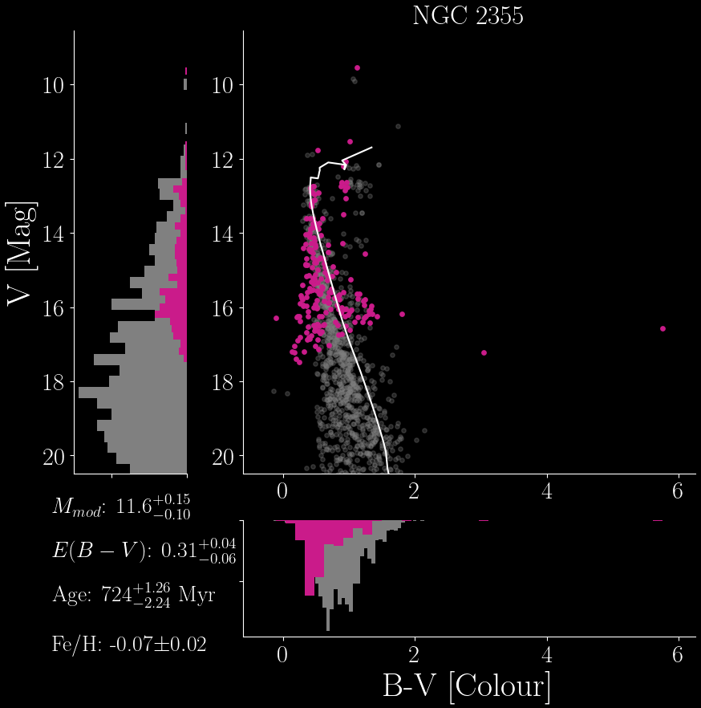
Observational Results
Using MIST Isochrones

Slide 12
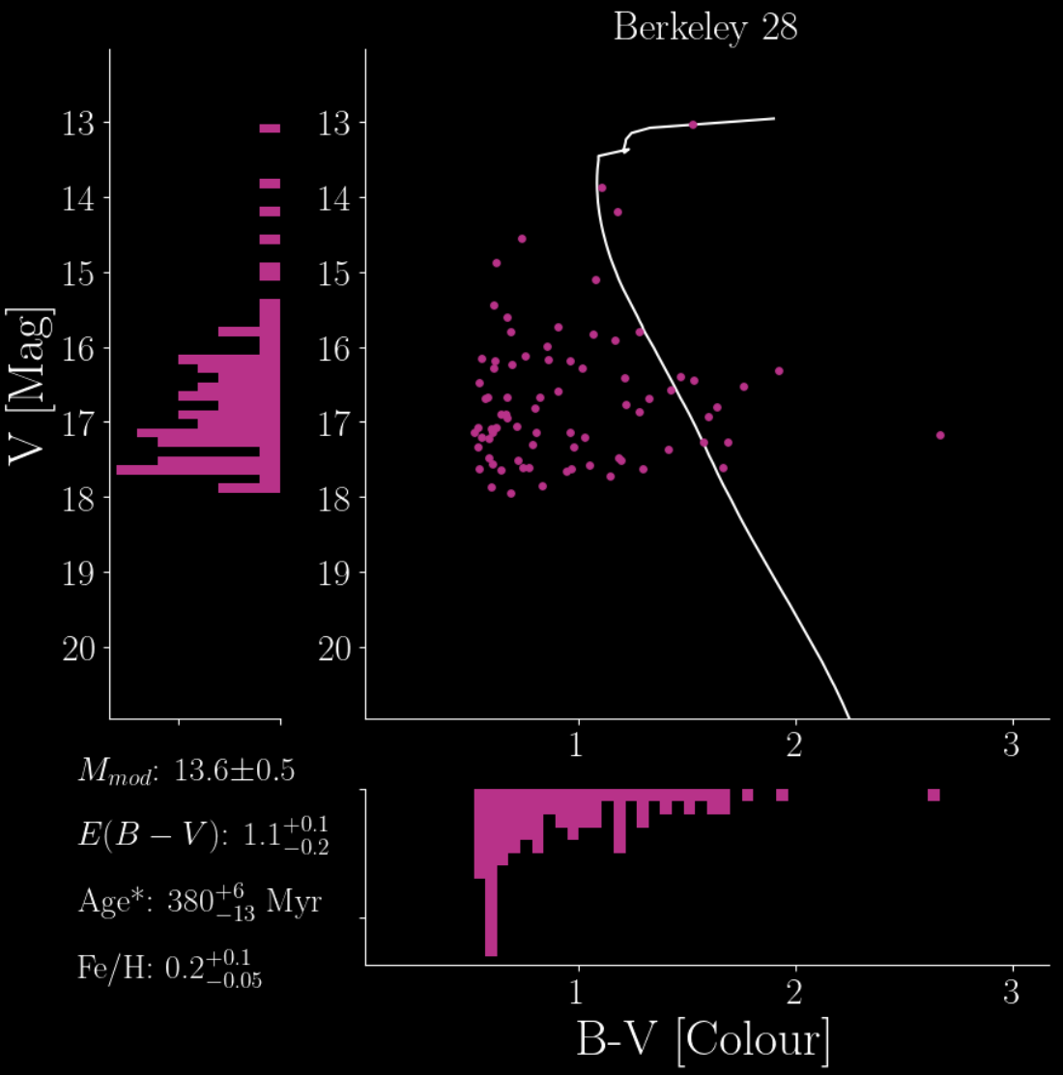
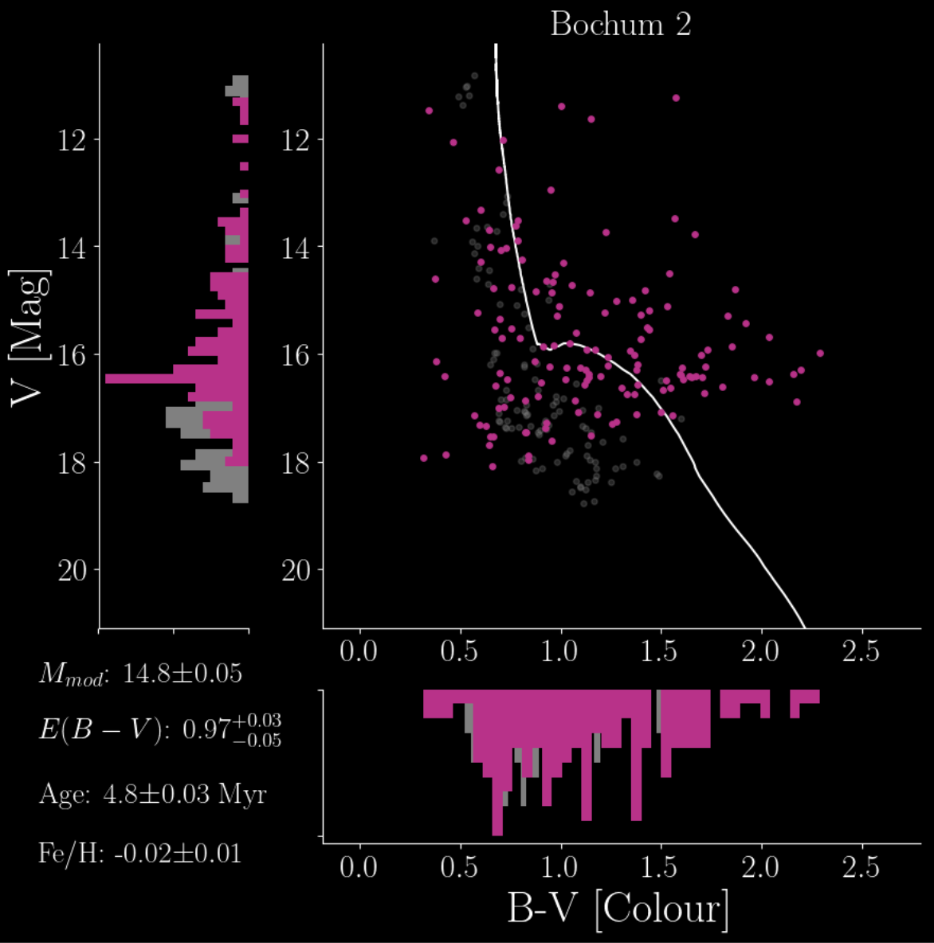

Slide 13
How do these compare to other values?
Target | Distance [Mod] | Log Age [yr] | Fe/H | Population* | WEBDA Study
NGC 2324 | 13.7/13.3/13.1 | 8.8/8.6/8.7 | -0.5/-0.5/- | 251/187/242 | Frandsen S., Arentoft T. (1998)
NGC 2355 | 11.6/12.1/11.4 | 11.6/11.8/9.0 | -0.07/-0.07/- | 209/266/261 | Kaluzny J., Mazur B. (1991)
Berkeley 28 | 13.6/14.4 /13.4 | 8.6/7.8/8.5 | 0.2/-/- | 79/77/53 | Mohan V. et al. (1988)
Bochum 2 | 14.8/14.7/- | 6.7/6.6/- | -0.02/-/- | 108/87/- | Turbide L., Moffat A.F.J. (1993)
Cantant-Gaudin et al. (2020)

Slide 14
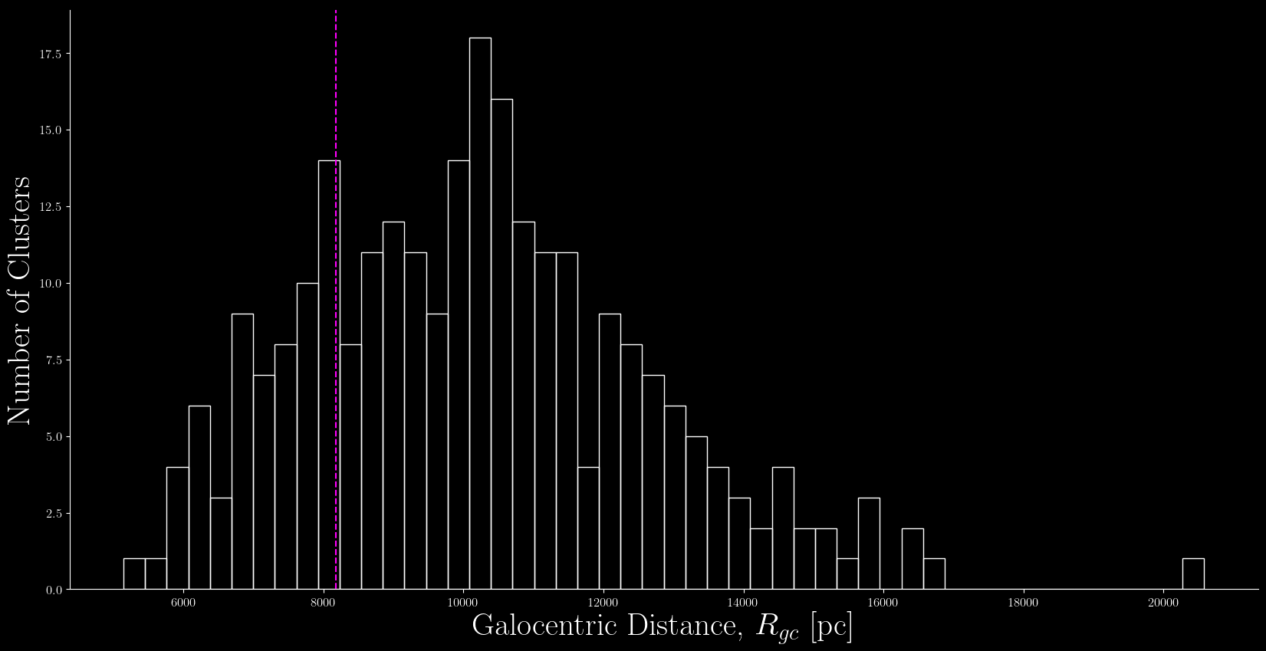
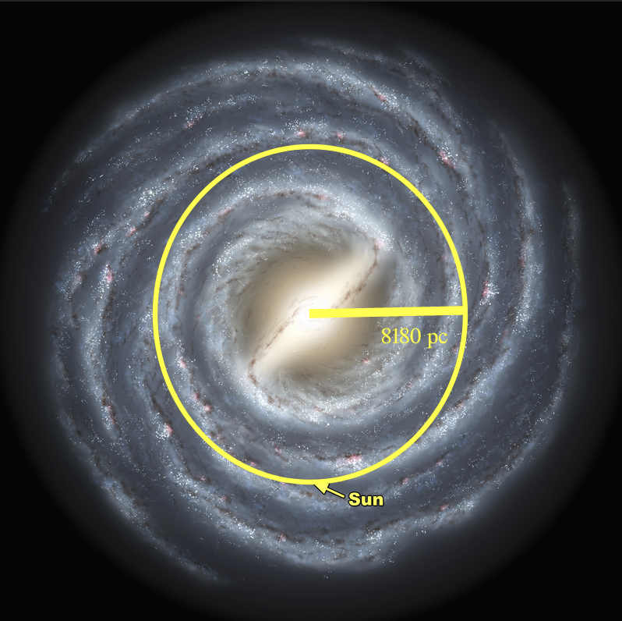
The Old Breed’s Distribution
Underabundance of open clusters in the inner disk.
Relationship between open clusters age and galactic position?
Distribution of Observed, Proposed and Cantat-Gaudin et. al
~8180 pc for Suns R_{gc} [Gravity Collab. , 2019 ]

Slide 15
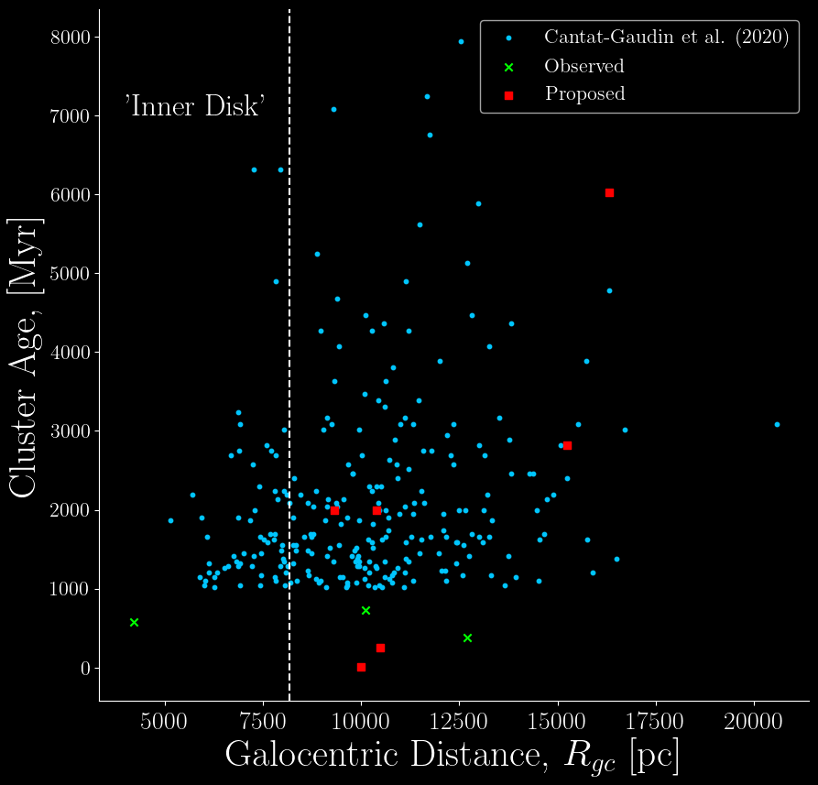
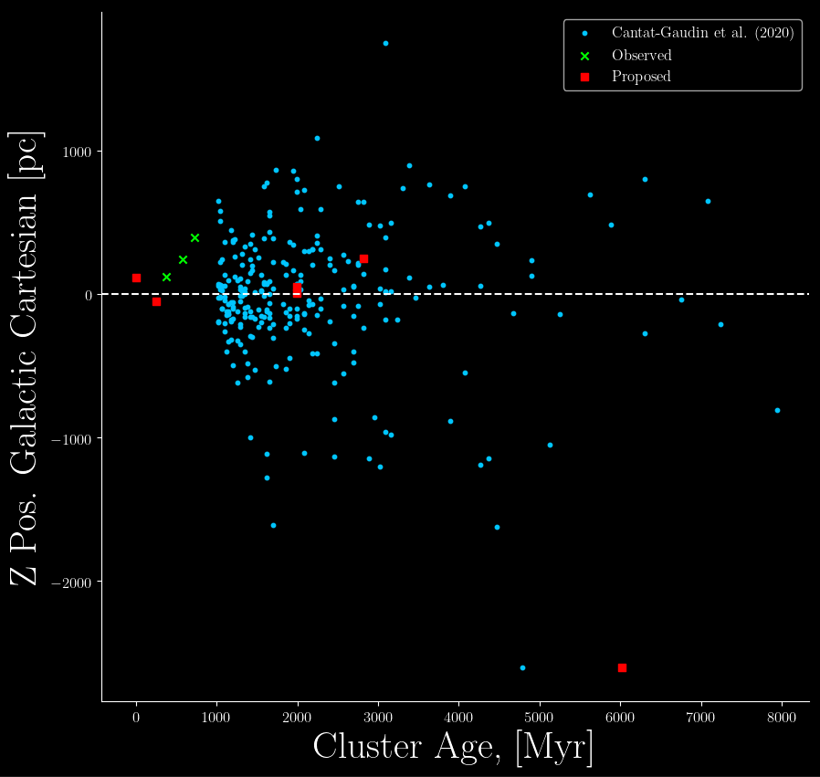
How these values add to mapping the Milky Way

Slide 16
My thought, correlation between age and location is non-existent
Contradicts initial predications by Oort [1950] and Spitzer [1958]
Oort assumed uniform star formation throughout the galactic disk. Lack of old open clusters was due to extrapolation from younger clusters.
Spitzer: Interactions with massive clouds at the core were the cause. Janes et al. [1988], cluster formation is too efficient for this to be the case.

Slide 17
Reasons for this?
Two of the oldest known clusters are within 200 pc from the plane, Be 17 (10 Gyr) and Cr 261 (8 Gyr)
Presence of old clusters like this among others don’t help the case for disruptive tidal forces
This is furthered by the presence of WEBDA clusters within the ‘inner disk’.
It’s also not surprising to find so many old clusters are found away from the galactic plane from an observational point of view.

Slide 18
Final Thoughts
The underabundance of the Old Breed in the disk is probably due to a nuanced relationship between cluster properties, internal dynamics and overall galactic environment
Answer lies with…
Astrometric data for old clusters looking at orbital motion
[Carraro and Chiosi, 1994]
Mass cataloging of cluster parameters, reddening & metallicity
[Cantant-Gaudin et al. 2020]
Spectroscopic surveys in tandem with Open Cluster classification
[Jackson et al. 2022]

Slide 19
The End… Questions? Feedback?

Slide 20
Slides to Aid Potential Questions

Slide 21
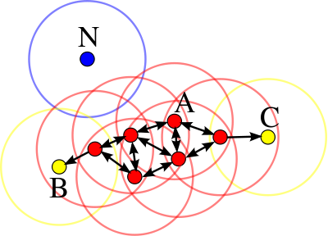
How does the Gaia data filter population
Using parallax and HDBSCAN
DBSCAN is an algorithm coined by Ester et al. (1996)
Identifies clusters and areas of high density based on two things!
Linking length!
Minimum neighborhood points

Slide 22
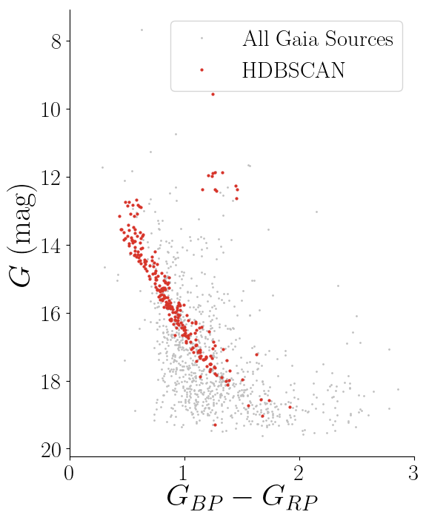
How does the Gaia data filter population
HDBSCAN depends only on the cluster size. It removes the need for a linking length.
It creates a minimum spanning tree by pruning off the nodes that do not meet the minimum number of stars in a cluster cluster, and reanalysing the nodes that do.
Designed by Kounkel C. et al. (2019)

Slide 23
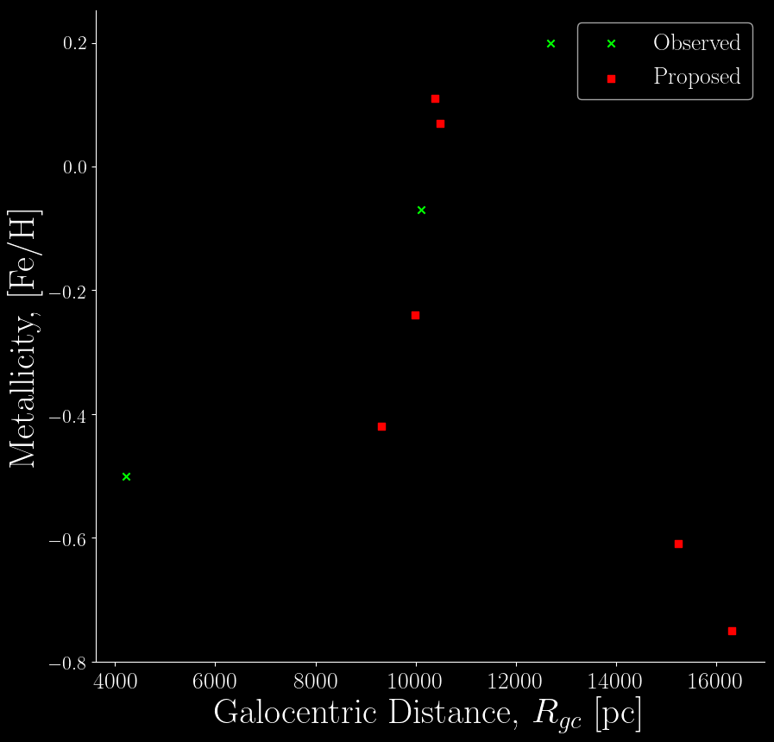
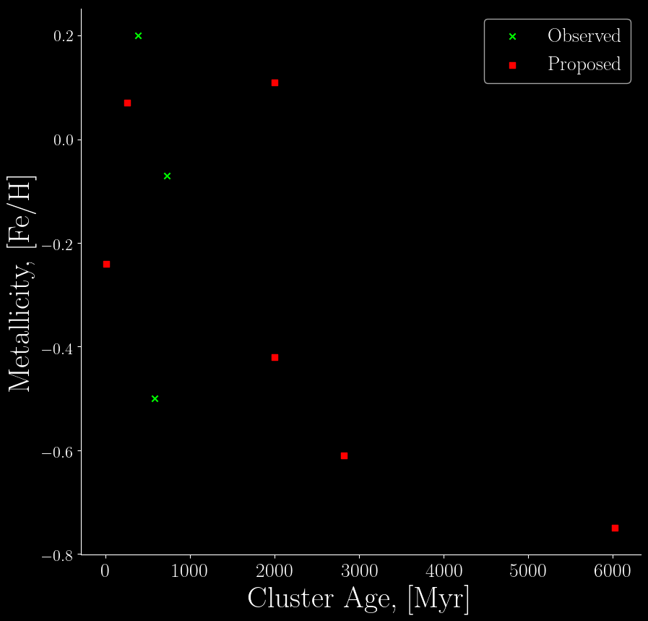
Metallicity relationship

